Slide 1

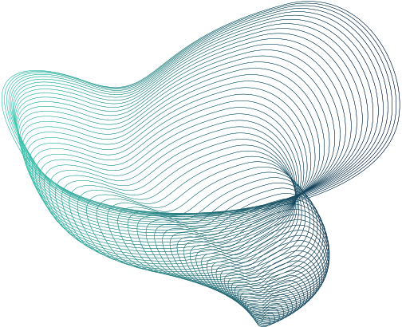
PATTERN RECOGNITION
CSE424
Paper Presentation

Slide 2
Paper :
Development of a Genetic Algorithm Based Geodesic
Active Contour for Iris Based Ethnicity
Prediction System
PRESENTED BY -
Name - Ashakuzzaman Odree
ID - 20301268

Slide 3

Abstract
The developments in science and technology have made it possible to use biometrics in applications where it is required to establish or confirm the identity of individuals. Among all possible biometric characteristics, the use of iris texture for recognition of individuals has been proven to be highly reliable. However, existing iris prediction systems have suffered from inability to handle more constrained acquisition (processing non-ideal iris images), high processing time and inappropriate parameter settings which usually results in inaccurate segmentation and poor classification results. This research therefore developed an improved segmentation and classification algorithms for iris-based ethnicity prediction system featuring the three major tribes in Nigeria.

Slide 4

Iris Recognition
Highly distinctive and stable characteristics.
Internally protected and stable from birth to death.
Expanding applications in various fields.
The Role of Biometrics
Physiological and behavioral traits unique to individuals.
Hard, soft, and hidden modalities.
Provides enhanced security and identity verification.
Introduction
The Complexity of Ethnicity
No standard scientific definition for measuring ethnicity.
Risk of misclassifying individuals into ethnic groups.
Biometrics can offer more reliable identification methods.

Slide 5
Previous Paper and Challenges
Previous Research Findings
Identified Challenges
"Iris Recognition Based on Three-Dimensional Imaging," by Arun Ross and Anil Jain in the IEEE Transactions on Pattern Analysis and Machine Intelligence in 2003.
"Iris recognition using a 3D deformable model" by S. Tariq and S. R. Memon, published in the Proceedings of the 14th International Conference on Frontiers in Handwriting Recognition in 2014.
"Iris recognition using 3D information" by S. S. Sujitha and K. B. Raja, published in the Journal of Ambient Intelligence and Humanized Computing in 2019.
Non-ideal iris images leading to under-segmentation and over-segmentation.
Challenges in processing non-ideal iris images and how GAGAC and GSOSVM address them.
Impact of environmental factors, e.g., non-uniform illumination and motion blur.
Match failures often rooted in inaccurate iris segmentation.
Need for larger datasets to validate models, e.g., Latinwo et al.

Slide 6
Extended Datasets
Enhanced Algorithms
Expand research to include more ethnic groups beyond Yoruba, Ibo, and Hausa.
Analyze performance across varied iris datasets, including those from different geographical regions.
Explore deep learning and neural network models for more nuanced classification.
Integrate hybrid algorithms combining the strengths of multiple optimization techniques.
Future Work and Scope
Real-world Applications
Interdisciplinary Collaboration
Application in border control, forensics, and personalized marketing.
Understand ethical implications and privacy concerns associated with iris-based ethnicity prediction.
Collaborate with sociologists and anthropologists to ensure cultural sensitivity and accuracy.
Partner with tech companies for the potential integration of developed systems into commercial devices.

Slide 7
METHODOLOGY

Slide 8
METHODOLOGY
Research Approach
Data Collection and Iris Database
Construction of iris database.
Formulation of GAGAC and GSO-SVM Algorithms.
Iris-based Ethnicity Prediction System design.
Software implementation in MATLAB R2020a.
Performance evaluation metrics.
Information on the tribes: Yoruba, Ibo, and Hausa.
Collection environments and methods.
Naming conventions for left and right irises.
Use of CMITECH Imager and desirable properties.

Slide 9
METHODOLOGY
Image Enhancement & Segmentation
Introduction to GSOSVM
Objective: Make iris features distinct.
Histogram equalization.
Segmentation using GAC and GAGAC.
Resulting iris images from segmentation process.
Optimization of Support Vector Machine (SVM).
Use of Radial Basis Function (RBF) kernel.
Importance of choosing best (C, γ) values.
Flow diagram of GSOSVM.

Slide 10
METHODOLOGY
Implementation Procedure
Performance Evaluation Metrics
Image acquisition using K-fold cross-validation.
Image preprocessing steps.
Feature encoding using Log Gabor Filters.
Classification using GSOSVM.
Introduction to evaluation metrics.
Definitions of False Positive Rate, Sensitivity, Specificity, Precision, and Accuracy.
Importance of these metrics in biometric systems.

Slide 11
RESULTS AND DISCUSSION
Presentation of Results
Results of Iris-based Ethnicity Prediction System
Discussion of Results

Slide 12
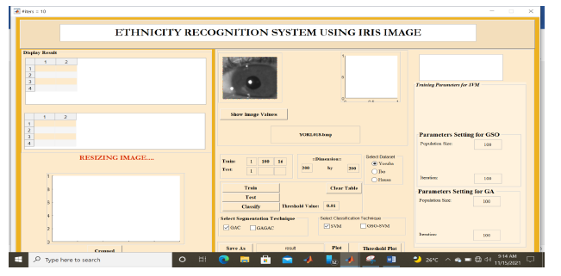
Presentation of Results
Introduction of metrics used: Sensitivity, Specificity, Precision, Accuracy, Classification Time.
Emphasis on the predictive capabilities of the system.
Evaluation based on three major tribes in Nigeria: Yoruba, Hausa, Ibo.

Slide 13
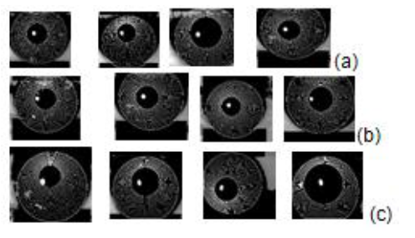
Results of Iris-based Ethnicity Prediction System
Parameter regularization techniques to avoid overfitting.
Improved performance at threshold 0.75 for Yoruba, Ibo, and Hausa tribes.
GAGAC/GSOSVM outperformed GAC/SVM across most metrics.

Slide 14
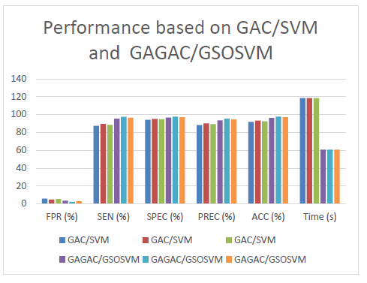
Discussion of Results
Challenges in processing non-ideal iris images and how GAGAC and GSOSVM address them.
Emphasis on the automatic parameter determination of GAGAC over conventional methods.
The role of Galactic Swarm Optimization in enhancing Support Vector Machine.

Slide 15
Conclusion
Emphasis on the improved accuracy and reduced time with GAGAC
GSOSVM's enhanced classification techniques
Final thought: Optimized algorithms (GAGAC and GSOSVM) outperform their standard counterparts (GAC and SVM).
Positive impacts of optimization on GAC and SVM
Significant evidence for the optimized algorithms' superior performance

Slide 16
THANK YOU

